Slide 1
MEDICAL STORE MANAGEMENT
Using HTML5, CSS3, JAVASCRIPT, MySQL,PHP

Slide 2

TEAM MEMBERS
1.A.N.S ANIL CHOWDARY-(1024)
2.GOGGALA AJAY RAJ –(1058)
3.CHENNAM VAMSI KUMAR REDDY-(1041)

Slide 3
Table of Contents
Abstract
Introduction
Scope of the project
Literature Survay
Existing System
Proposed system
Problem Statement
Difference Existing system VS Proposed system
Implementation of code
Conclusion

Slide 4
Abstract
The medical store management system is a software application designed to automate and streamline the management of inventory, sales, and purchases in a medical store or pharmacy.
The system helps in improving the efficiency of various tasks, reducing manual errors, and providing real-time data for better decision-making. The system features inventory management, sales management, purchase management, and accounts management modules.
It helps in optimizing stock levels, avoiding stockouts, and minimizing wastage The ultimate goal is to ensure that medical stores have the necessary resources to meet the needs of their customers and provide quality healthcare.

Slide 5
Introduction
A medical store management system is a software application that automates the management of inventory, sales, purchases, and other related activities in a medical store or pharmacy.
This system helps to streamline the overall process of managing and organizing various medical products and medicines effectively. The primary objective of this system is to simplify the day-to-day operations of a medical store, reduce manual errors, and increase efficiency.
It helps the store owner to keep track of the stock levels, monitor the expiry dates of medicines, and manage the accounts payable and receivable. The medical store management system can be customized to suit the needs of different types of medical stores, such as hospitals, clinics, retail pharmacies, and wholesale distributors.
The system can be accessed by authorized personnel from any location, which allows for efficient management of multiple stores or locations.

Slide 6
The medical store management software enables to maintain the details of purchase stock by the store and the details of the selling stock by customer wise (Hull, 2012).
This software generates the automated bill for every sale and also generate the reports for the customer detail, sell and stock.
The use of this system reduces the time and effort involved in managing inventory of the medical store. It also reduces the hard work involved in using paper for record keeping.
The use of this system enables the managers to easily record the details of their suppliers and assess them whenever required.
The use of medical store management system improves the efficiency of staff of the store as it provides information about the medicines and its location in the store.
The medical store management system can give ease to the medical stores in managing their paper work, payment details and inventory online along with retrieving them.

Slide 7
Aim of the project
A project on medical store management refers to the development of a software application that automates and streamlines the management of inventory, sales, and purchases in a medical store or pharmacy. The project involves designing and implementing a system that enables medical stores to optimize their inventory levels, minimize wastage, and provide better customer service.
Scope of the project
The scope for a medical store management system is broad, and it can benefit various stakeholders in the healthcare industry, including medical store owners, managers, employees, and customers.
Purpose of the project
In proposed system there is no need to maintain data about medicine because all process of that medical store management system project report data done in computerized. The modern age the age of computer is an electronic device, which fetched record very quickly. The computers are very quickly accepted as it as many advantages such as speed, accuracy, security etc. In that medical shop management system project report proposed system all the add, edit, delete, search in project of computer are done through computerized system.

Slide 8
Literature Survay
[PAPER 2.1] Improving medical stores management through automation and effective communication
Authors: Mudera P Cariappa , Mudera P Cariappa , Maj Gen Mukti Sharma’s
Abstract:
Background: Medical stores management in hospitals is a tedious and time consuming chore with limited resources tasked for the purpose and poor penetration of Information Technology.
The process of automation is slow paced due to various inherent factors and is being challenged by the increasing inventory loads and escalating budgets for procurement of drugs.
Methods: We carried out an in depth case study at the Medical Stores of a tertiary care health care facility. An iterative six step Quality Improvement (QI) process was implemented based on the Plan-Do-Study-Act (PDSA) cycle.
The QI process was modified as per requirement to fit the medical stores management model. The results were evaluated after six months.
Results: After the implementation of QI process, 55 drugs of the medical store inventory which had expired since 2009 onwards were replaced with fresh stock by the suppliers as a result of effective communication through upgraded database management.
Various pending audit objections were dropped due to the streamlined documentation and processes. Keywords: medical stores, Inventory management, PDSA cycle, QI processs

Slide 9
[PAPER 2.2] Big data in healthcare: management, analysis and future prospects
Authors:
Sabyasachi Dash, Sushil Kumar Shakyawar, Mohit Sharma, and Sandeep Kaushik
Abstract:
‘Big data’ is massive amounts of information that can work wonders. It has become a topic of special interest for the past two decades because of a great potential that is hidden in it. Various public and private sector industries generate, store, and analyze big data with an aim to improve the services they provide.
In the healthcare industry, various sources for big data include hospital records, medical records of patients, results of medical examinations, and devices that are a part of internet of things. Biomedical research also generates a signifcant portion of big data relevant to public healthcare.
This data requires proper management and 4 analysis in order to derive meaningful information. Otherwise, seeking solution by analyzing big data quickly becomes comparable to fnding a needle in the haystack. There are various challenges associated with each step of handling big data which can only be surpassed by using high-end computing solutions for big data analysis.
That is why, to provide relevant solutions for improving public health, healthcare providers are required to be fully equipped with appropriate infrastructure to systematically generate and analyze big data. An efcient management, analysis, and interpretation of big data can change the game by opening new avenues for modern healthcare. Key Words: - Healthcare, Biomedical research, Big data analytics, Internet of things, Personalized medicine, Quantum computing

Slide 10
Existing System
Now a days we do all work with computerized system but with current syst em is very complicated to keep the track of all registers and handle them manually. As well as that medical store management system project report work is time consuming & also expensive in that medical store management system work may be not accurate and not fastest.
Disadvantages
• Time consuming…
• More expensive…
• Searching problem…
• Maintains problem of all registers…
• Less accuracy…
• Problem for marking of not normal value…
• More stationary…
• Display multiple reports…

Slide 11
PROPOSED SYSTEM
In proposed system, the management needs not to keep any type of registers, which they use to keep in old one. They have work only with one computer. All the detail are computer files. The dual entries are done very quickly as entry in one file only affects the other file where it has to record. In the way there is no need to record the computer operator.
The working through registers system is not only very laborious and time consuming , but there are number of errors found. In comparison to old system.
Disadvantages
1. Time saving…
2. Less expensive…
3. Powerful searching…
4. Solve the problem of maintains register…
5. More accuracy…
6. Easy generate report…
7. Not display multiple reports…

Slide 12
Problem Statement
Many medical stores face challenges with managing inventory, sales, and customer information efficiently. The current manual system of record-keeping is time-consuming and prone to errors, leading to stock shortages, expired medicines, and dissatisfied customers.
Therefore, there is a need for a computerized system that can automate the process of managing inventory, sales, and customer information in a medical store.
The medical store management system should be able to keep track of inventory levels, generate alerts when the stock is low, and automate the ordering process with suppliers.
The system should also be able to record sales transactions, track customer information, and generate reports to provide insights into the store's performance.
Additionally, the system should be user-friendly and accessible to employees with varying levels of technical expertise. It should have appropriate security measures to ensure that sensitive information is protected.
The objective of the medical store management system is to increase efficiency, reduce errors, and improve customer satisfaction by automating key business processes.

Slide 13
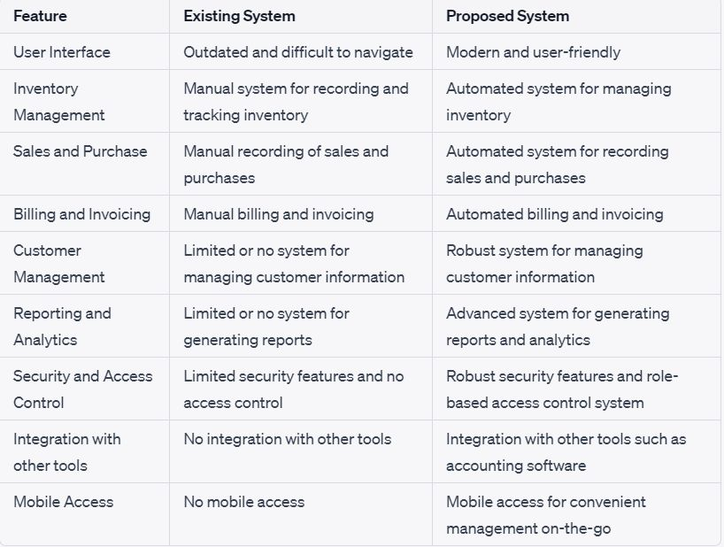
DIFFERENCE EXISTING SYSTEM VS PROPOSED SYSTEM

Slide 14
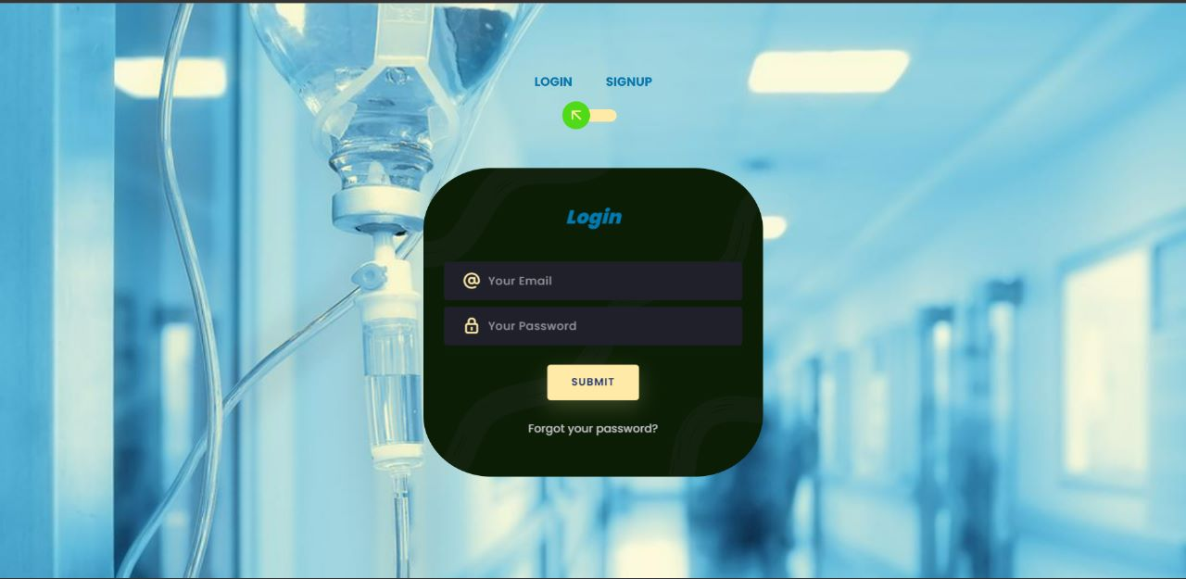
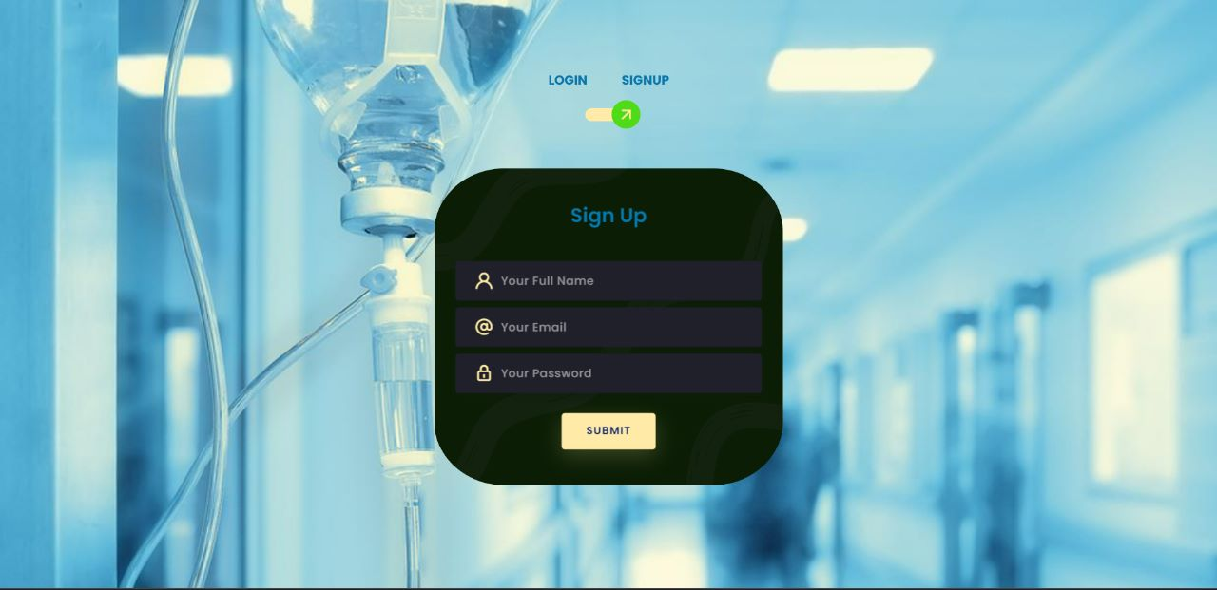
IMPLEMENTATION OF CODE :

Slide 15
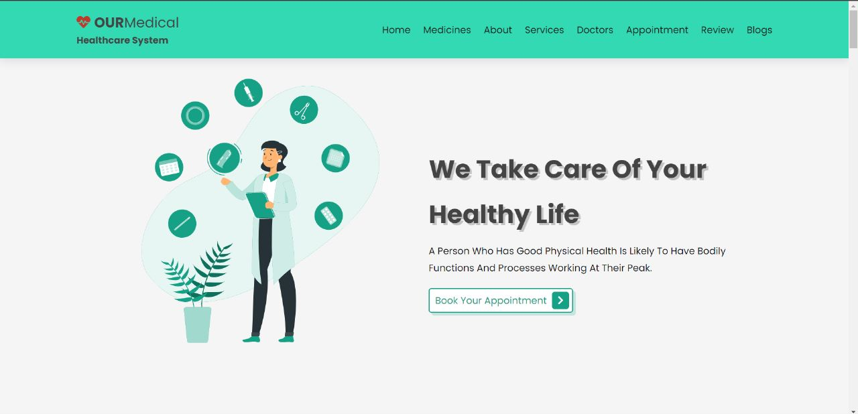

Slide 16
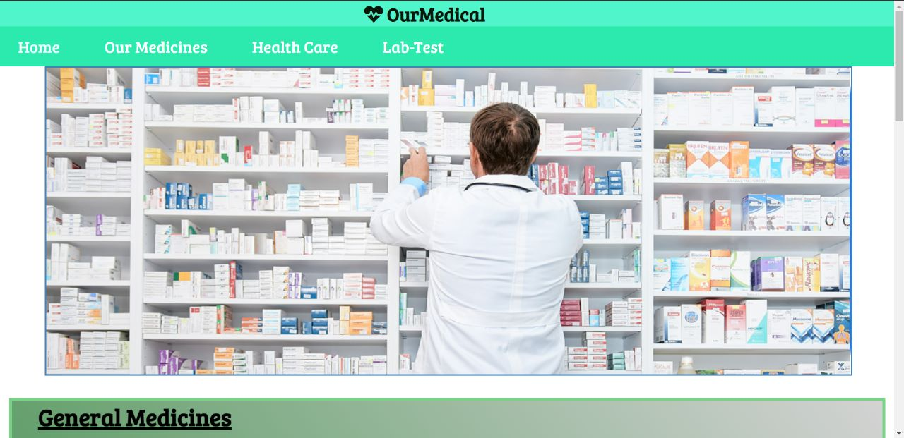

Slide 17
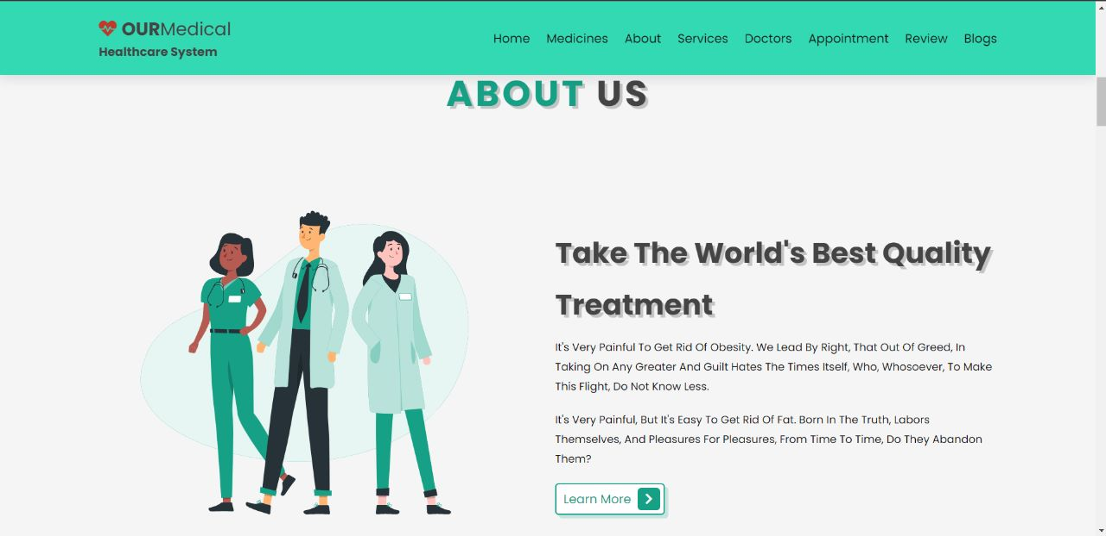

Slide 18
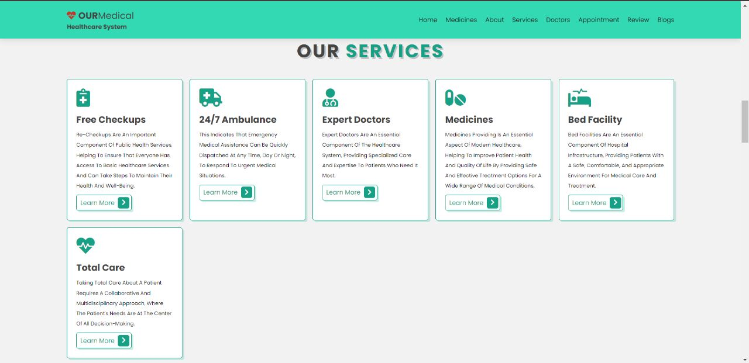

Slide 19


Slide 20
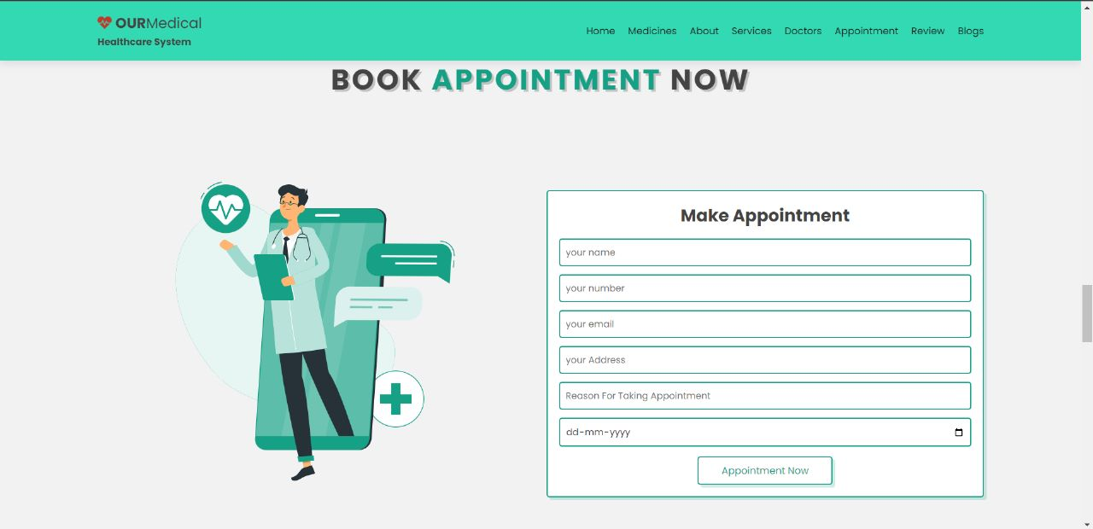

Slide 21
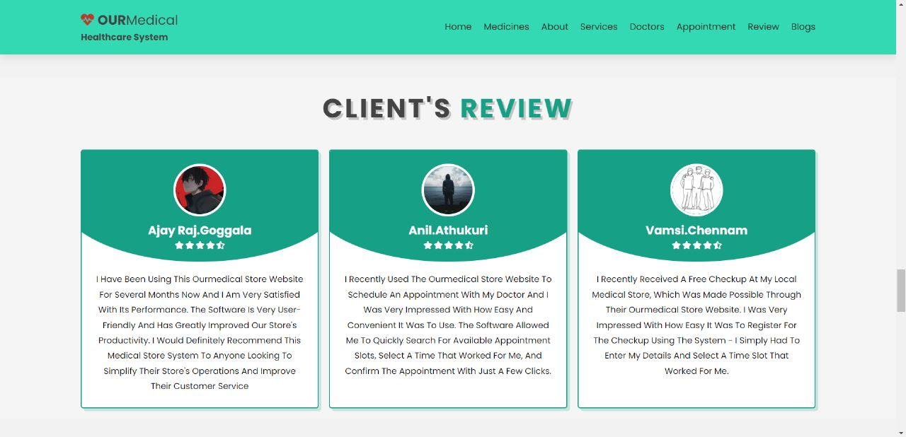

Slide 22
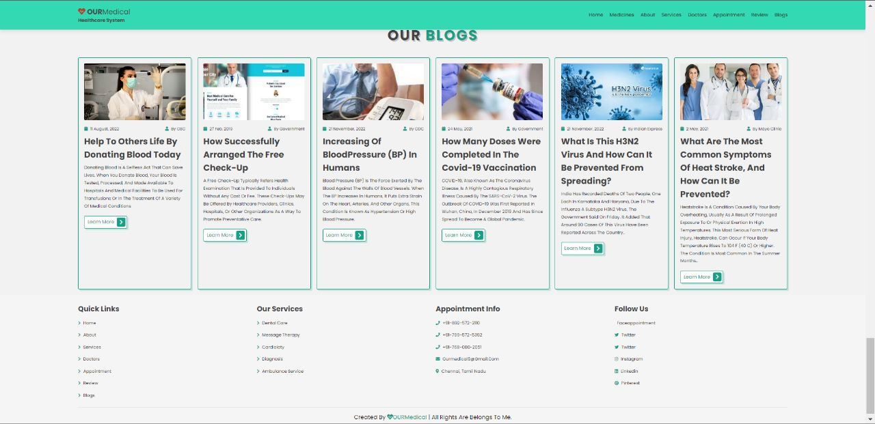

Slide 23
CONCLUSION
In conclusion, the medical store management system is a crucial tool for managing the inventory, sales, and purchases of medical products and medicines in a medical store or pharmacy.
By automating various processes, the system can help in improving efficiency, reducing errors, and providing real-time data for better decision-making.
The system's features, such as inventory management, sales management, purchase management, and accounts management, enable medical stores to optimize their stock levels, avoid stockouts, and minimize wastage.
The system also provides accurate information on sales trends and customer behaviour, helping medical stores to provide better customer service and increase profitability.

Slide 24


